Slide 1



Erasmus+ CBHE Project
International Students Adaptation and Integration/ INTERADIS
619451-EPP-1-2020-1-NL-EPPKA2-CBHE-JP
Monitoring
Online
01.10.2021

Slide 2


WP 1.
WP | Activity | Timing | Indicator
1.1.a | Study visits online | April 2021 | # of SV Program corresponds to the project goals # of participants
1.1.b | Study visits offline (smts combined with Trainings) | October- May 2022 | # of SV Program corresponds to the project goals # of participants
1.2. | Analysis of as-is situation at HEI | April 2021 | List of points for analysis (questionnaire) Analysis, reports, action plans uploaded on GD
1.3.a | General report prepared after online | April-May 2021 | Results of evaluation of study visits
1.3.b | Action plan and reports prepared after offline | After each SV, Final – May-June 2022 | Quality control report General report

Slide 3

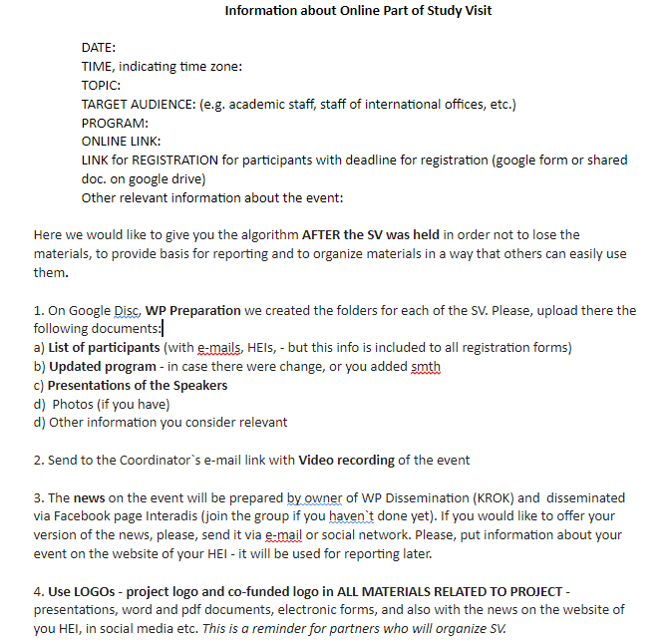
Online parts of SV
Preparation of the schedule of SVs – NLBA, KROK and EU partners
Preparation of the template with program and structure of SV – NLBA, KROK
Setting of the date, preparation of the program – EU partners
Informing of partners about dates and program of SV – NLBA, KROK
Preparation of the folders with informational materials on SV – NLBA, KROK
Preparation of the news on website, Fb - KROK

Slide 4
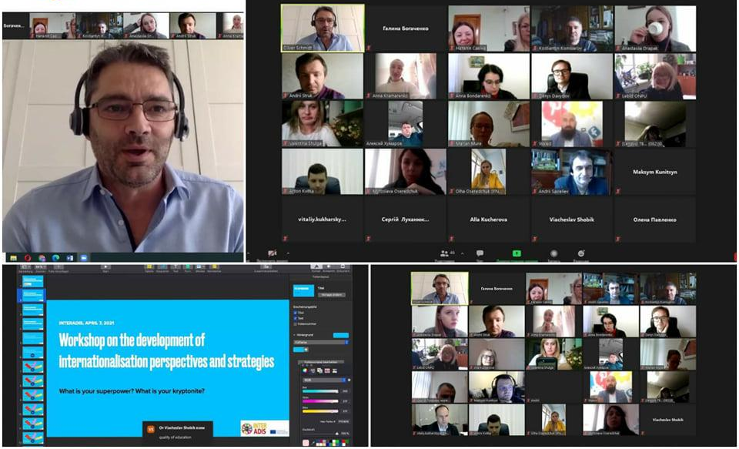
Online Part of Study Visit by Hultgren Nachhaltigkeitsberatung UG
7 April Online Part of Study Visit within EU Erasmus+ project “International Students Adaptation and Integration/ INTERADIS” was organized by Oliver Schmidt, CEO of Hultgren Nachhaltigkeitsberatung UG, Germany.
The Corona pandemic poses major challenges for all of humanity, challenges that can obviously only be met as a community. Our global world is not only digitally networked and technically developed, but also vulnerable. Science shows how important a systematically controlled process of internationalization also for Universities is. The internationalization of degree programs at Ukrainian universities as planned in INTERADIS creates important conditions for this.
In the process, these and other questions were discussed at the workshop:
How do we convince key internal and external partners and stakeholders to support us in this endeavor?
How do we as a university develop a good strategy and what resources do we need for this?
How do we reach students abroad?
And what marketing methods are available to place our offer to students well and to be able to compete against competing universities at home and abroad?

Slide 5
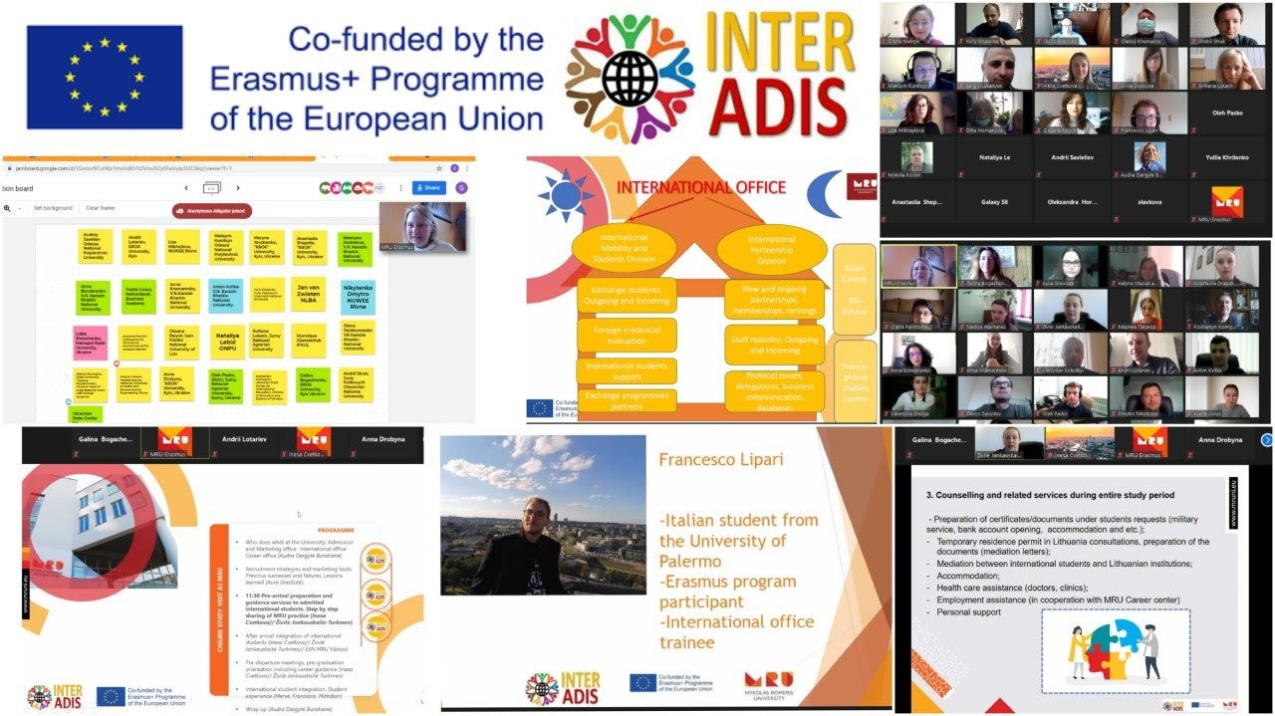
Online Part of SV "International students admission and integration practices of Mykolas Romeris University"
14 April 2021 the Online Part of Study Visit "International students admission and integration practices of Mykolas Romeris University" was held in the frameworks of the project INTERADIS "International Students Adaptation and Integration" gathering 57 participants from EU and Ukrainian HEIs.
The host of the Online Visit, Mykolas Romeris University (Lithuania), presented to the participants short information on the following topics:
Admission and Marketing office, International office, Career office
Recruitment strategies and marketing tools. Previous successes and failures. Lessons learned.
Pre-arrival preparation and guidance services to admitted international students. Step by step sharing of MRU practice
After arrival integration of international students. (Introductory week, orientation, student mentors (or student ambassador’s) activities from arrival, socio-cultural integration, mid-term follow-up, counselling and related services during entire study period)
Pre-departure meetings, pre-graduation orientation including career guidance (graduate traineeships, TRP for graduates to seek employment )
International student integration. Student experience.

Slide 6
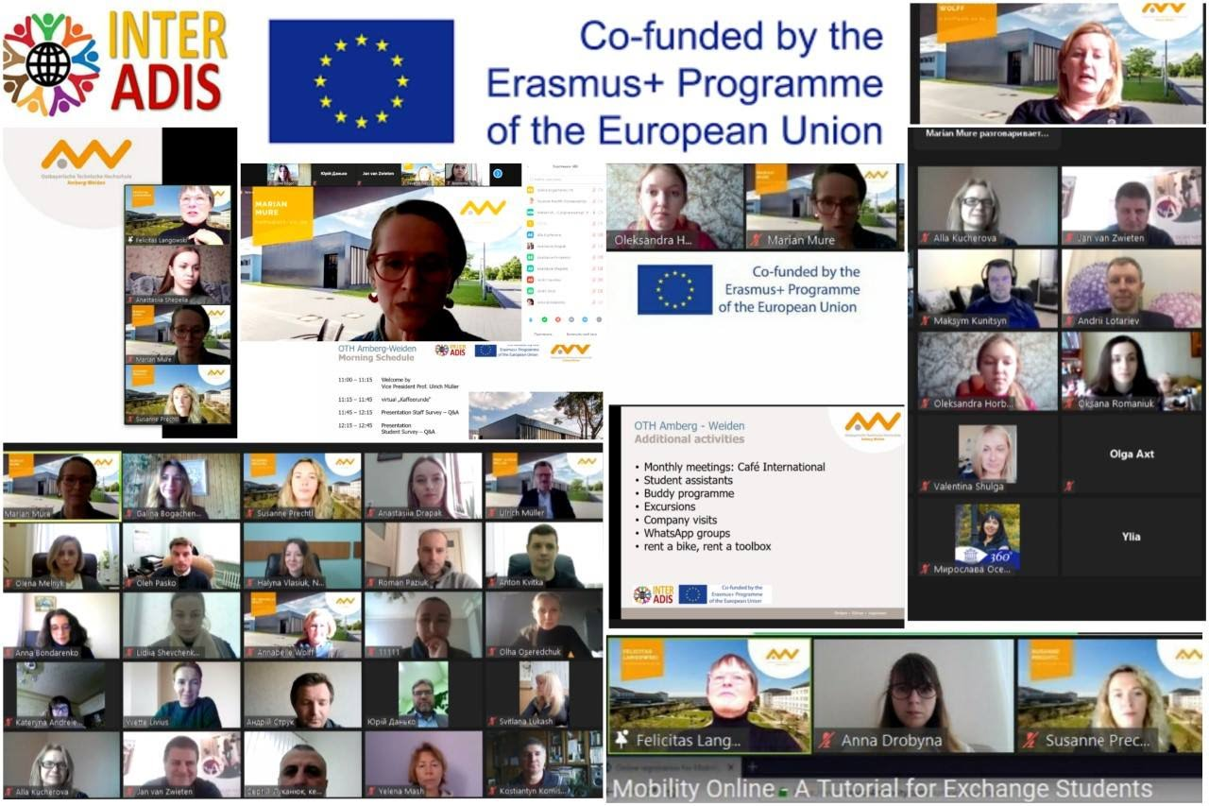
Online Part of Study Visit "Data outcome from surveys. Admission and Integration practices“ by Ostbayerische Technische Hochschule Amberg-Weiden
16 April 2021 the Online Part of Study Visit "Data outcome from surveys. Admission and Integration practices" by Ostbayerische Technische Hochschule Amberg-Weiden, Germany was held in the frameworks of the project INTERADIS "International Students Adaptation and Integration".
The program of the online visit included:
Virtual "Kaffeerunde" with wonder.me
Data Analysis of survey outcome (group work - allocating the responses to work packages)
Best Practice@OTH AW with the head of the international office Dr. Annabelle Wolff
Tools for coordinating the international student life cycle: Mobility Online, Orientation Days, Buddy Program
Networking possibilities for international offices in German

Slide 7
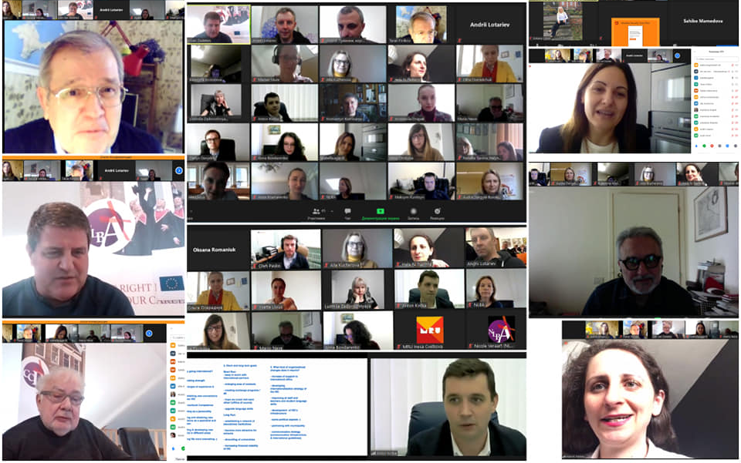
Online Part of Study Visit, organized by Netherlands Business Academy
20 April 2021 the Online Part of Study Visit "Introduction to Intercultural Communication" by Netherlands Business Academy, the Netherlands, was held in the frameworks of the project INTERADIS "International Students Adaptation and Integration".
The program of the online visit included:
Opening by Jan van Zwieten and Steve Austen “Short and long term ambition on internalization”
Presentation by Jan van Zwieten "why internationalization"
Panel discussion
Group discussion, answering the questions: “Why going international”, Short and Long term goals”, “What kind of organizational changes does it require”.
Presentations of panelists:
Taras Finikov "How to acquire intercultural competences"
Izabella Agardi "Aspects of image building and identity construction"
Mario Neve "The context of place and environment"
Hala Naoum Nehme "European citizenship issues, a personal experience".

Slide 8
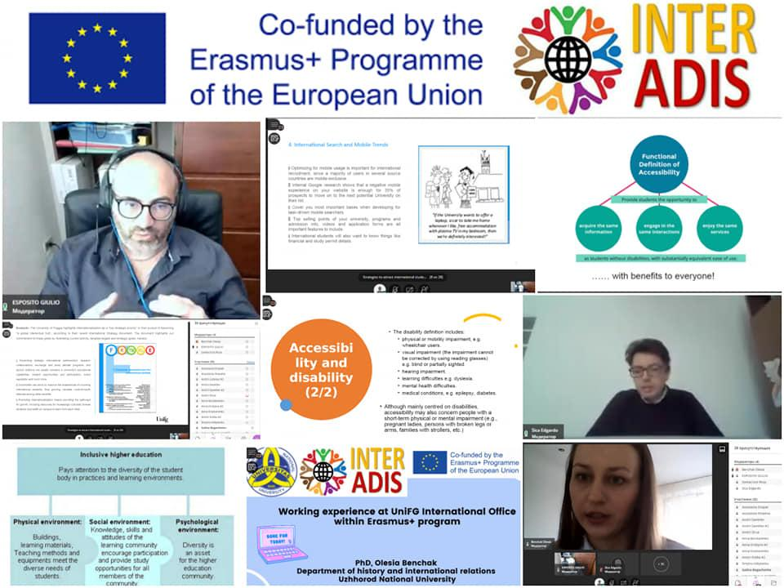
Online Part of Study Visit organized by University of Foggia, Italy
28 April 2021 the Online Part of Study Visit organized by University of Foggia, Italy was held in the frameworks of the project INTERADIS "International Students Adaptation and Integration".
The Eprogram of the visit included the following topics:
prof. Stefano Netti: "The COVID-19 pandemic and the university system: new challenges and new opportunities for development and internationalization of Ukrainian Higher Education Institutions"
prof. Edagardo Sica, Topic: "International students and disability: ensuring accessibility to the Ukrainian higher education system"
prof. Domenico Viti, Topic : “Smoothing students’ culture gap: enhancing mutual understanding and relationship when studying in Ukraine”
PhD Olesia Benchak - Department of history and international relations, Uzhhorod National University, topc: “Working experience at UniFG International office within Erasmus+ program”
Giulio Esposito, topic: “Strategies to attract international students. Sharing best practices of University of Foggia in adaptation of international students”
A lot of thanks to the organizers of event – University of Foggia for an interesting and fruitful study visit!

Slide 9
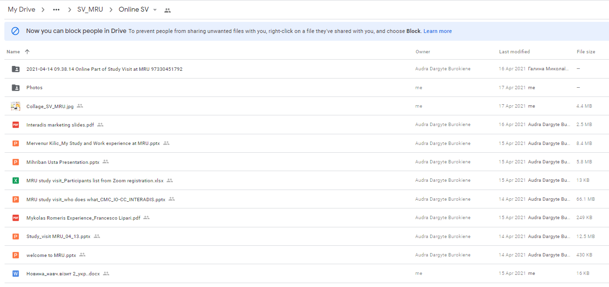
Materials on Study Visit
Example of the materials of the SV, uploaded on google disc

Slide 10
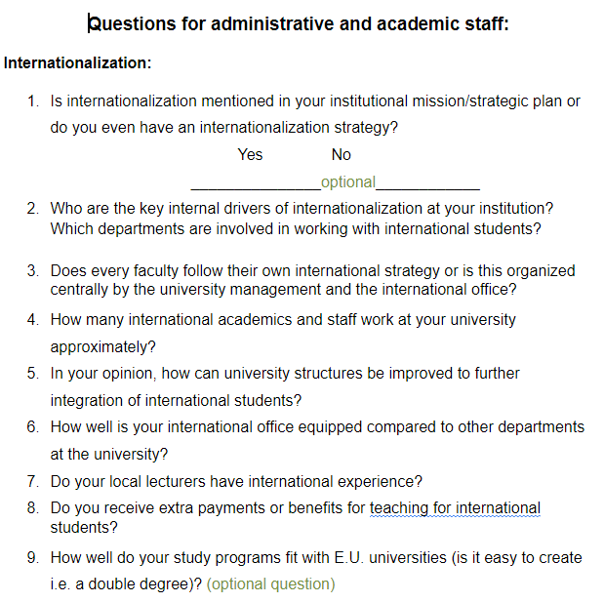
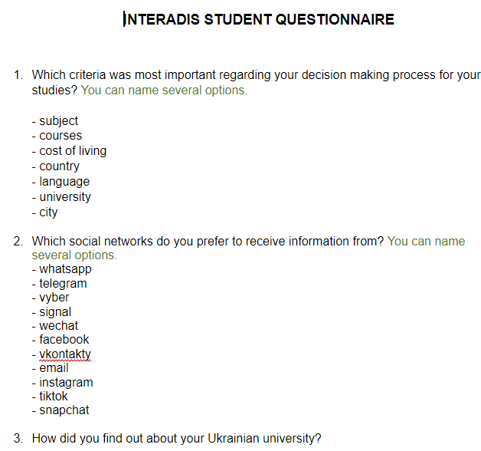
Questionnaire
Prepared by Ostbayerische Hochschule Amberg-Weiden, on the basis of list of issues, prepared by Ukrainian partners

Slide 11
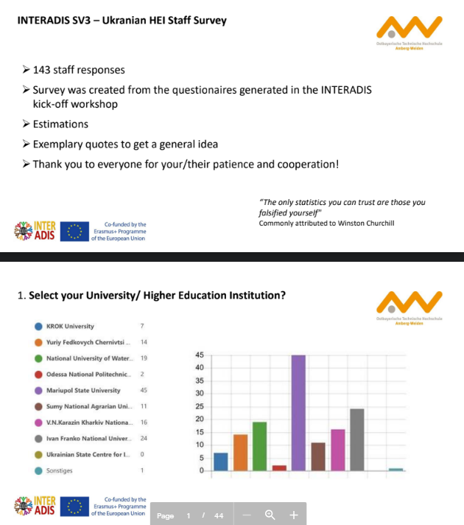
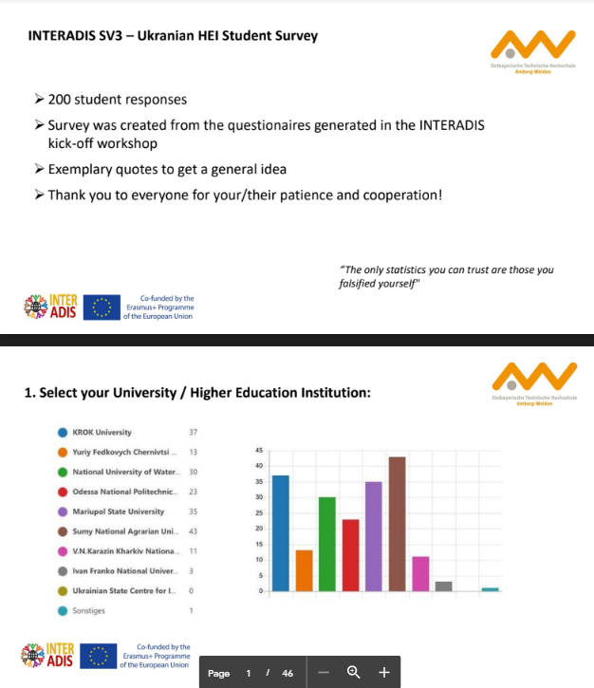
Staff and Student Survey
https://drive.google.com/drive/u/1/folders/1WyOFI-6dkTwuyIIJ5DgpHzuqKRXqbxCq
https://drive.google.com/drive/u/1/folders/1WyOFI-6dkTwuyIIJ5DgpHzuqKRXqbxCq

Slide 12
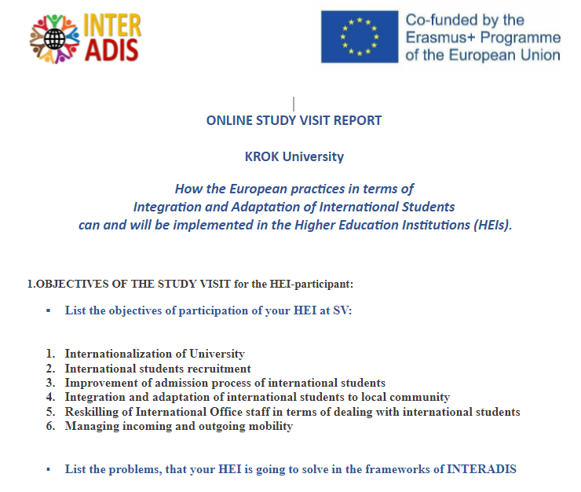
General Report on WP 1
General Report on online part of SV, prepared by NLBA and KROK, filled by Ukrainian HEIs

Slide 13
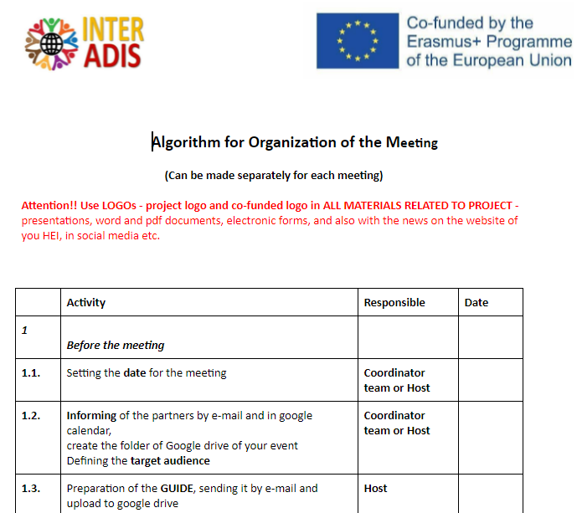
List of offline events
11-15 October | SV+Training | Vilnius, Lithuania
22-26 November | under consideration, may be cancelled | NLBA, the Netherlands
24-26 November | Meeting of the Rectors, Festivities, can be also combined with PSCM3 | NLBA, the Netherlands
December/January 2021 |  | OTH-Amberg, Germany
May, June 2022 |  | Foggia, Italy

Slide 14
WP 2 KhKNU
KhKNU will report on WP 2
WP 3
Started partially in parallel with WP 2, but has to follow WP2
WP 4
Consortium and hosts of the meetings will try to combine Trainings with SV

Slide 15
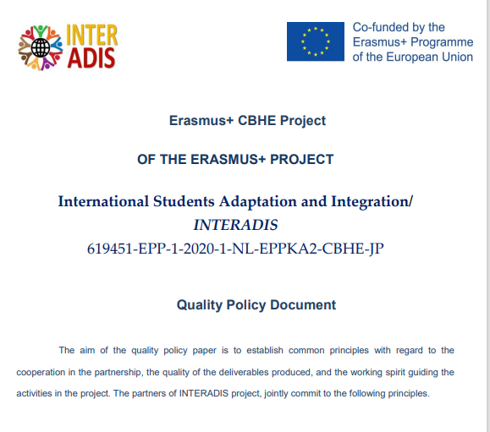
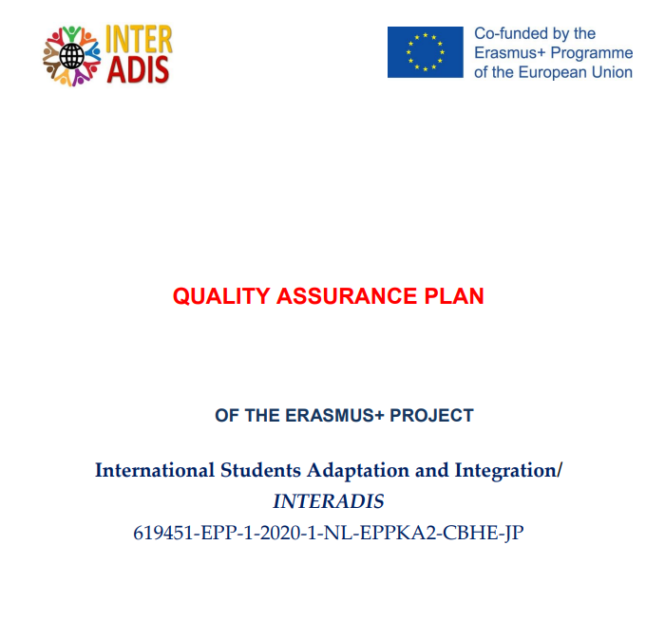
WP 5. Quality Management
Quality Police Document prepared (draft)
Quality Management Plan prepared (draft)
Workshops are planned for 04 October 2021 (PSCM2) to update the documents taking into account online SV, implementation of WP2 and planning of WP 3

Slide 16
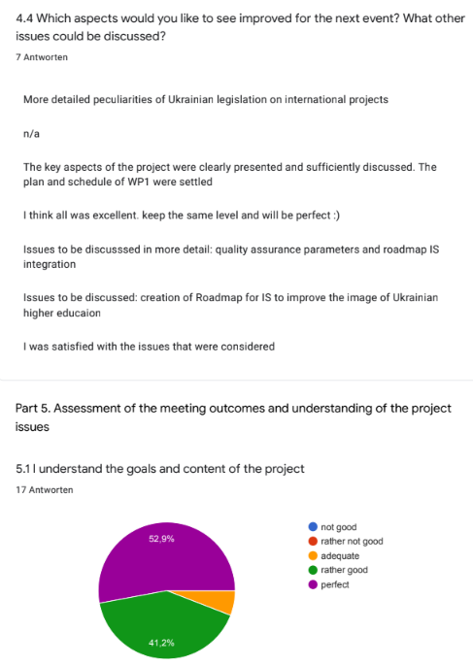
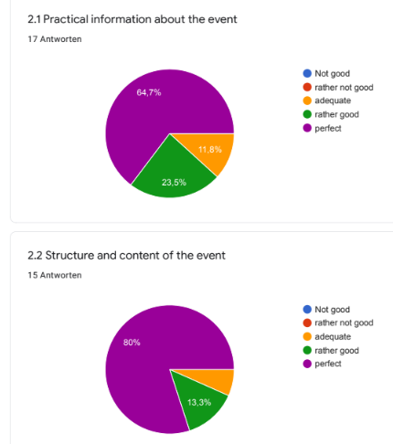
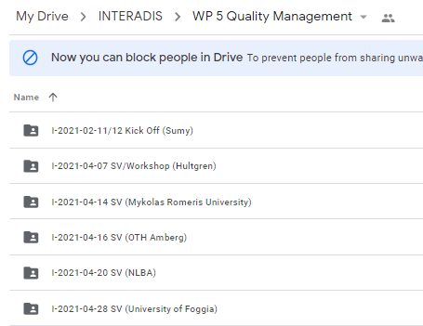
WP 5. Quality Reports on Meetings (kick-off and online SVs)

Slide 17
WP 6. Dissemination and Sustainability activities
6.1. Promotional materials prepared and disseminated
6.2.Project website is online and updated
6.3.Dissemination events organized
6.4.Monthly newsletter issued
6.5.Results of project presented at the annual conference of international education
6.6.Publication published
6.7. Infocampaign for Ukrainian students, staff and society organized
6.8.Partnerships developed
6.9. Recommendations regarding IS policy prepared and transferred to Ukrainian State Centre of International Education, MES

Slide 18
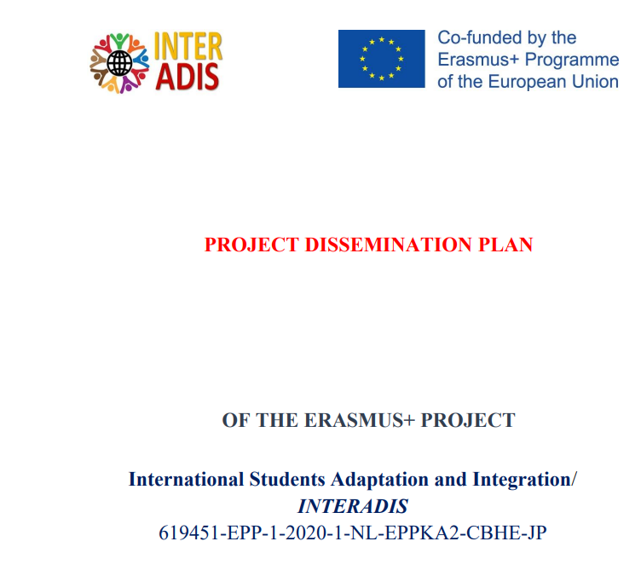
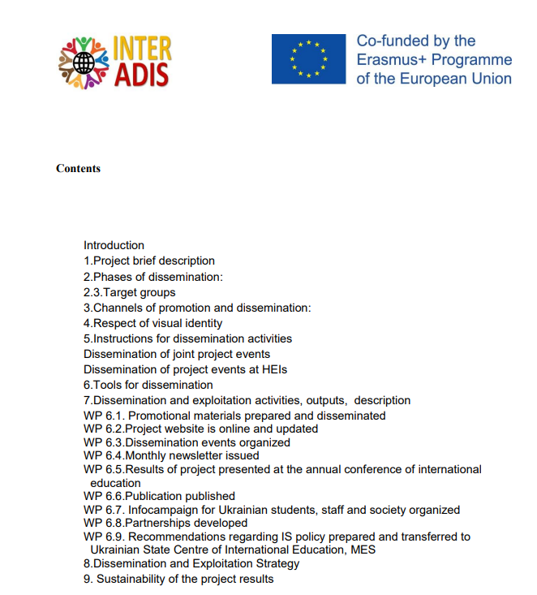
Dissemination and Sustainability
Instructions for partners:
Information about the project on the website of your HEI in English and national language and provide the links
In the project activities mention your team as “member of EU Erasmus+ project INTERADIS”
After the event the partners prepare the news with collage or set of pictures from the project meeting with project logo and Erasmus+ logo stating that the project was co-financed by European Commission respecting the visual identity rules.
The news has to be placed on the website of the partner, posted in social media, with the use of #INTERADIS.
The news has to be sent to KROK for project newsletter.

Slide 19
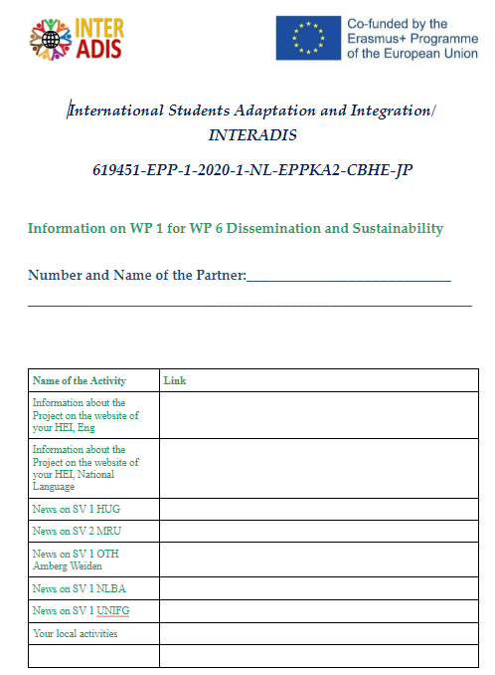
Project
Template on check of posting of the news, that is filled by all partners

Slide 20
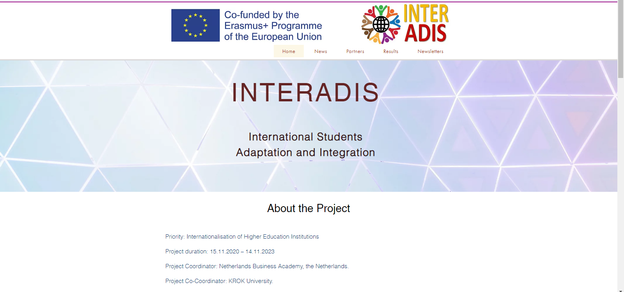
6.2.Design and update of project website
Project website contains
info about the project
Meetings with pictures
Newsletters
Project key documents
Short information about the partners

Slide 21
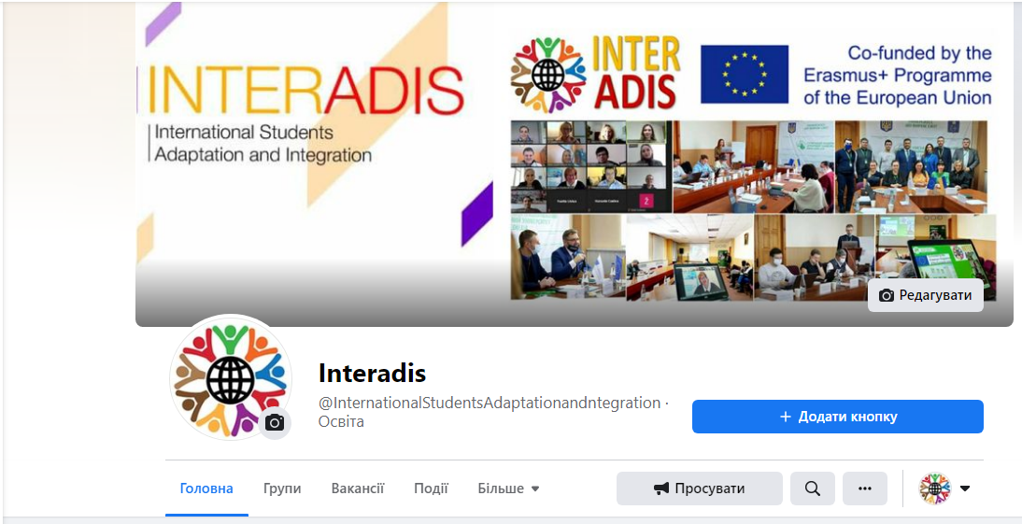
Facebook group
https://www.facebook.com/InternationalStudentsAdaptationandntegration

Slide 22
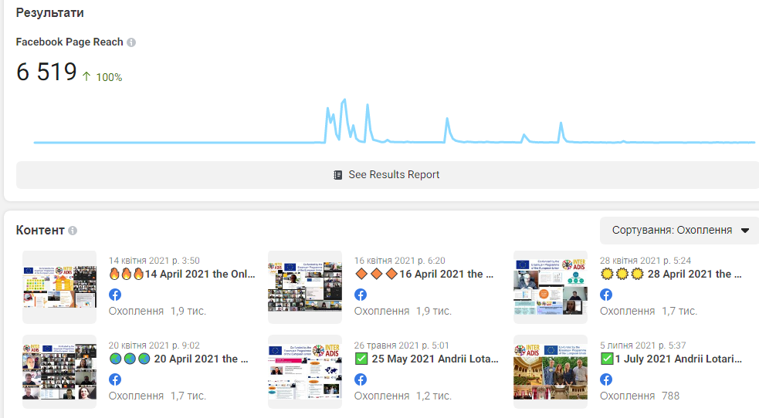
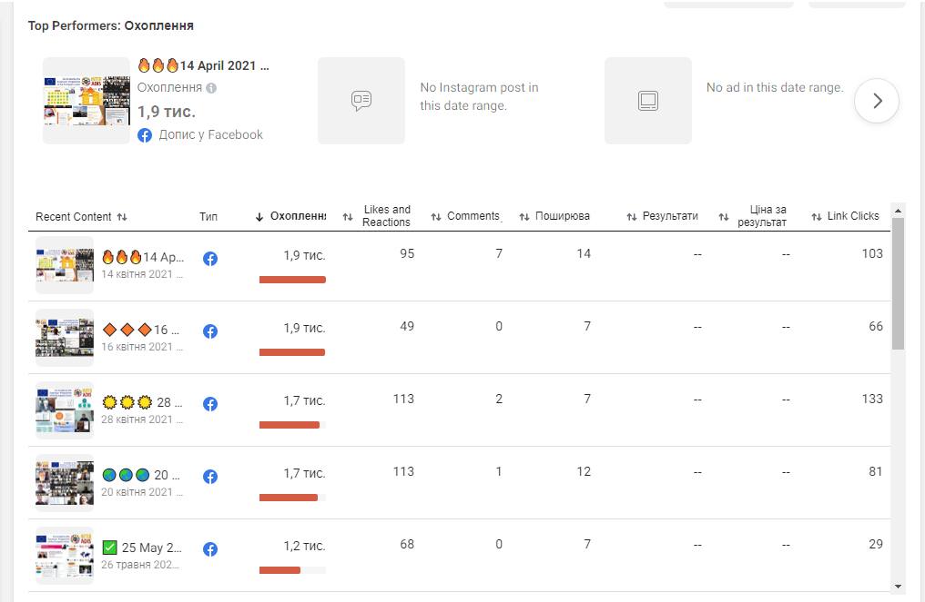
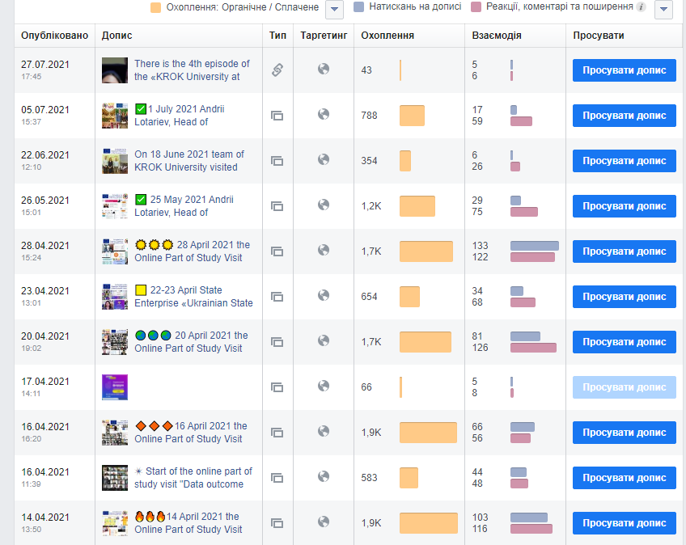
Facebook group statistics

Slide 23
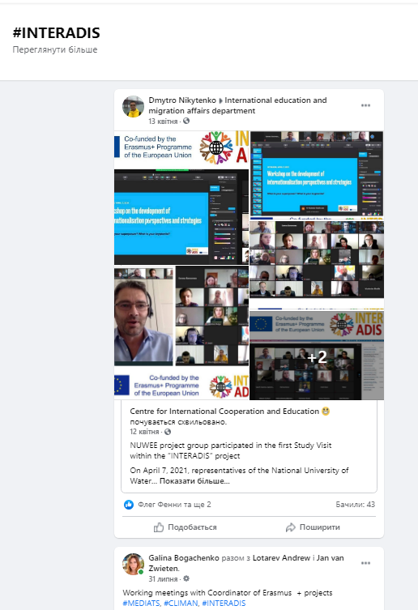
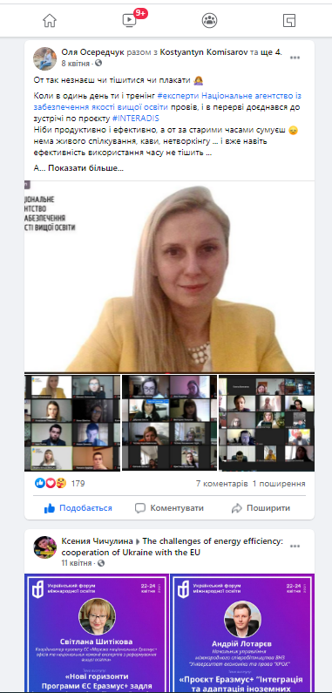
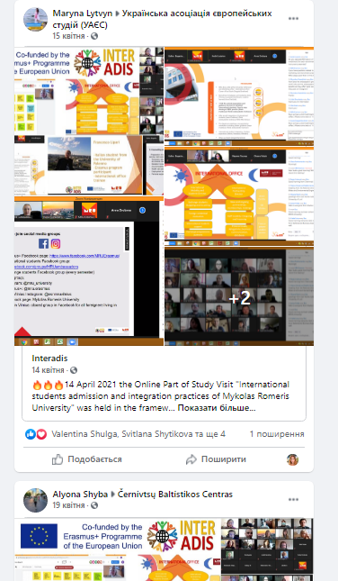
#INTERADIS
https://www.facebook.com/hashtag/INTERADIS/

Slide 24
Project logo.

Slide 25
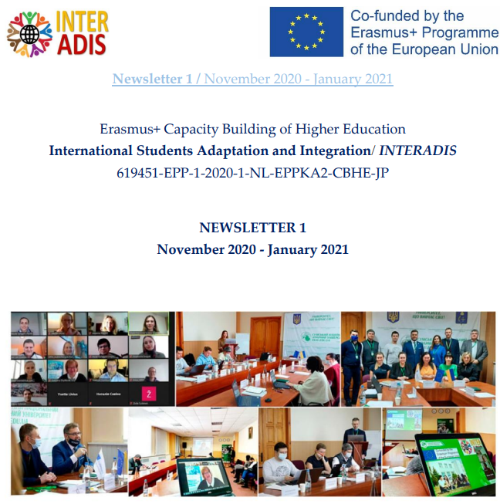
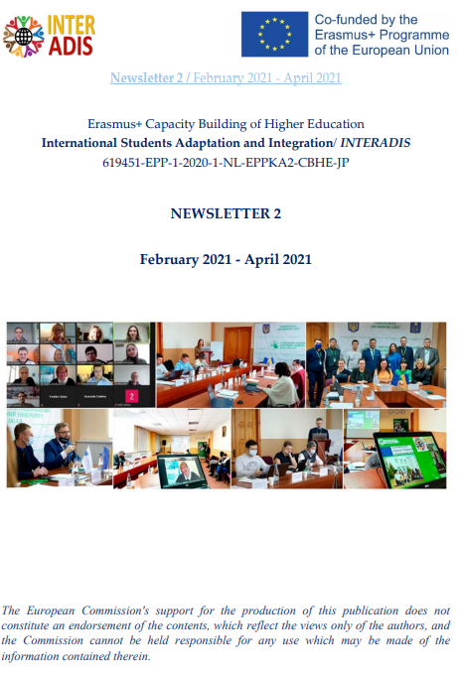
WP 6.4.Issuing of newsletter
The materials that can be prepared– news and partner updates, articles, info on events, useful links, successful stories, useful and interesting experience, statistics, reports as well as info of partners, students and alumni.
The newsletters will be also placed on the project website

Slide 26
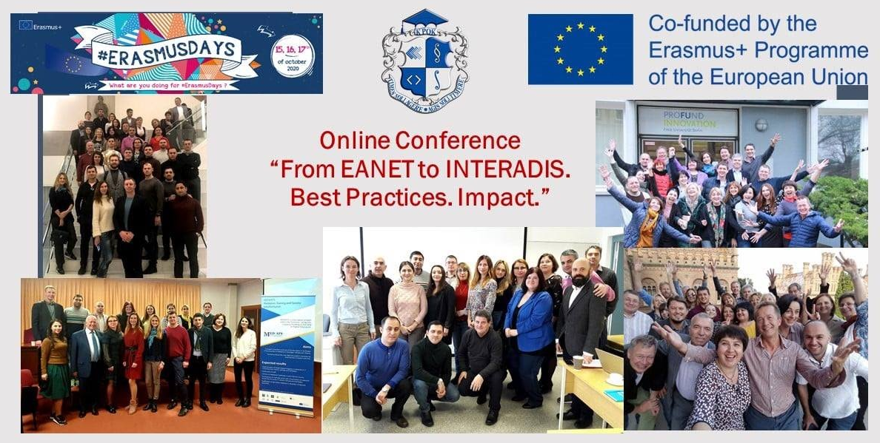
WP 6.7. Promocampaign
On 16 October 2020 the Online Conference “From EANET to INTERADIS. Best Practices. Impact.”, dedicated to #ErasmusDays, was organized by KROK University.
At the meeting the patners of EANET, MEDIATS, INTERADIS, CLIMAN and COOPERA discussed the infuence of Erasmus+ projects on their life and career. "Tempus project EANET was the best that happened to me during the last 10 years, besides family issues", " Once Erasmus - always Erasmus", "Friendship and Sustainaility are the most important issues of the projects", "Thanks to EANET experience we received 4 more projects", "FRIENDSHIP -ДРУЖБА - FREUNDSCHAFT"- these were the key sayings.

Slide 27
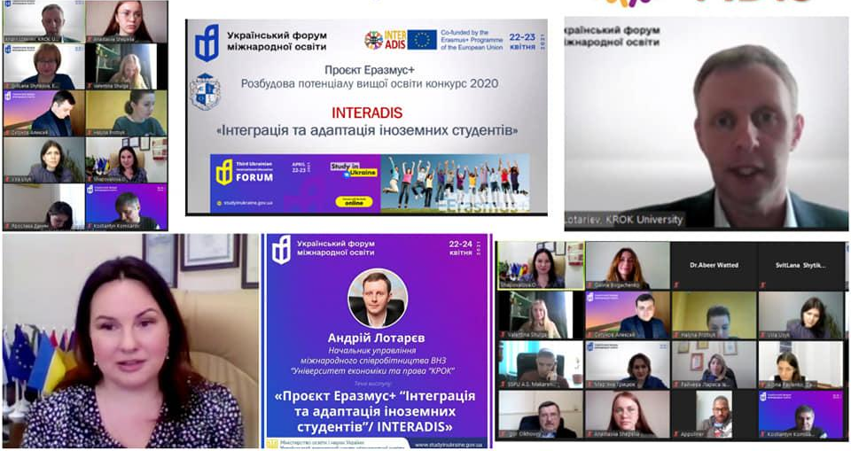
Presentation of INTERADIS project at Third Ukrainian International Education Forum
22-23 April 2021 State Enterprise «Ukrainian State Center for International Education» of the Ministry of Education and Science of Ukraine, partner of INTERADIS project, organized Third Ukrainian International Education Forum.
Different speakers mentioned that international Students integration and adaptation is crustal for successful development of international education.
Andrii Lotariev, Head of International Office of KROK University, presented the Erasmus+ project co-coordinated by KROK ”International students adaptation and integration - INTERADIS” to about 8 000 visitors of the Forum. He outlined the target audience, goals, tasks, indicators, partners, activities of the project; invited to participate in the analysis of situation with international students integration at other HEIs of Ukraine. For now 30+ Ukrainian HEIs sent their applications to join the project.
The participants listened to speeches by leading Ukrainian and foreign educational administrators, diplomats, scientists, experts and specialists in the field of higher education internationalization.
Topics of the forum include:
modern trends in the internationalization of higher education
organization of recruitment and education of foreign students in Ukraine
development of cooperation in the field of international education
marketing in education
development of departments for work with foreign students in HEIs

Slide 28
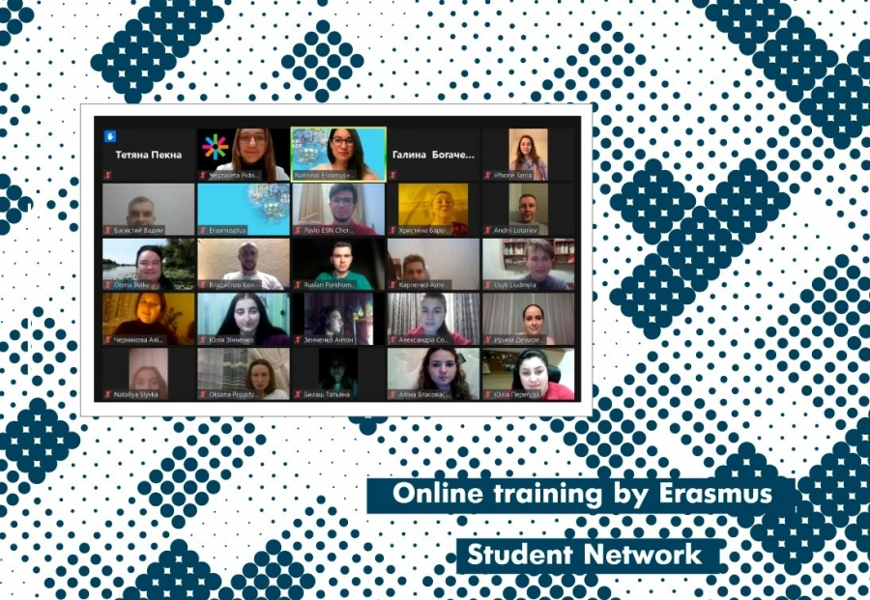
Presentation of INTERADIS at event of Erasmus Student Network
On February 19, 2020, an online training by Erasmus Student Network Kyiv (ESN Kyiv) took place. The event joined more than 60 representatives of teams from International Relations Departments and Universities’ Student Council from all over Ukraine.
The training’s aim was to get to know the possibility of creating a similar ESN community at the university, the peculiarities of ESN Kyiv's work with incoming foreign students to Ukrainian universities for exchanges, as well as to show tools and cases of implementing an effective Buddy System. The event was attended by Andrii Lotariev, Head of International Office of «KROK» University, and Halyna Bohachenko, Project Manager of «KROK» University. The speakers presented the Erasmus + project INTERADIS «International Students Adaptation and Integration».

Slide 29
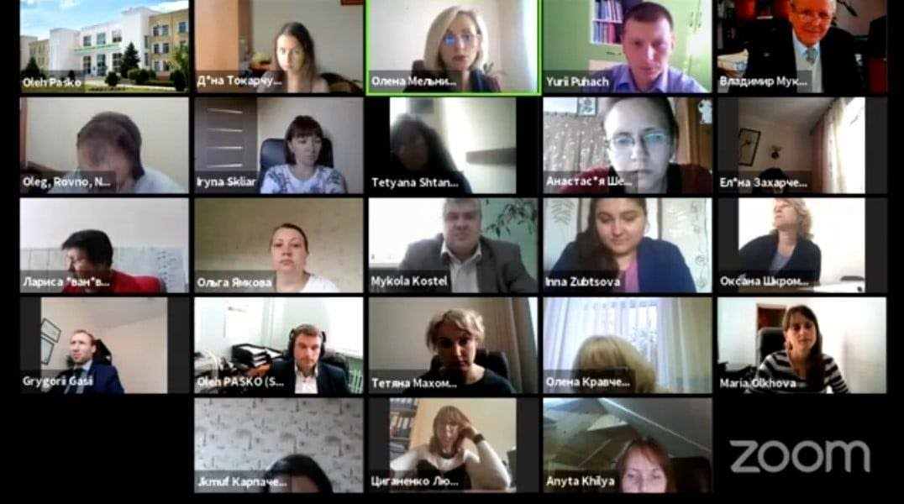
Presentation of INTERAIS at Online Training Seminar
“Fundraising. Writing Projects. Successful Cases”
On October 6-7, 2020, an online training seminar «FUNDRAISING. WRITING PROJECTS. SUCCESSFUL CASES» took place.
Andrii Lotariev, Head of International Office of «KROK» University and Oleh Pasko, Head of Research Coordination Office of Sumy National Agrarian University, presented INTERADIS «International Students Adaptation and Integration».
The event was organized by the National Erasmus + Office in Ukraine, Sumy National Agrarian University and National Contact Point Horizon 2020. The educational opportunities of the EU programs Erasmus +, Horizon Europe, Green Deal and other opportunities for fundraising in the field of education were presented there.

Slide 30
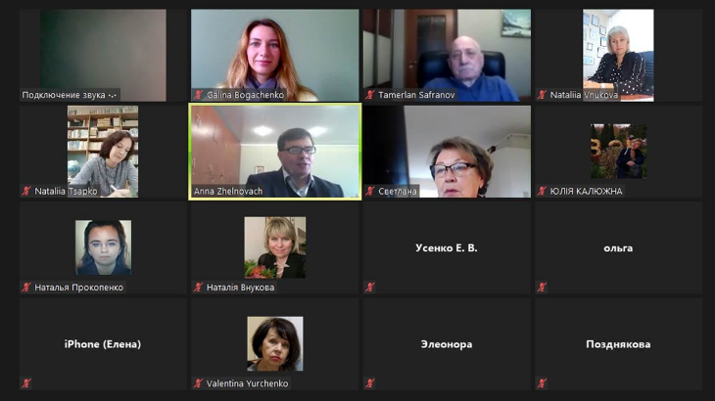
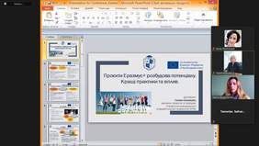
Presentation of INTERADIS at V All-Ukrainian scientific-methodical conference «Modern aspects of organizational and methodological support of the environmental component of professional training»
On October 22, 2020, the V All-Ukrainian scientific-methodical conference «Modern aspects of organizational and methodological support of the environmental component of professional training» was held online on Zoom platform, dedicated to the 90th anniversary of Kharkiv National Automobile and Highway University.

Slide 31
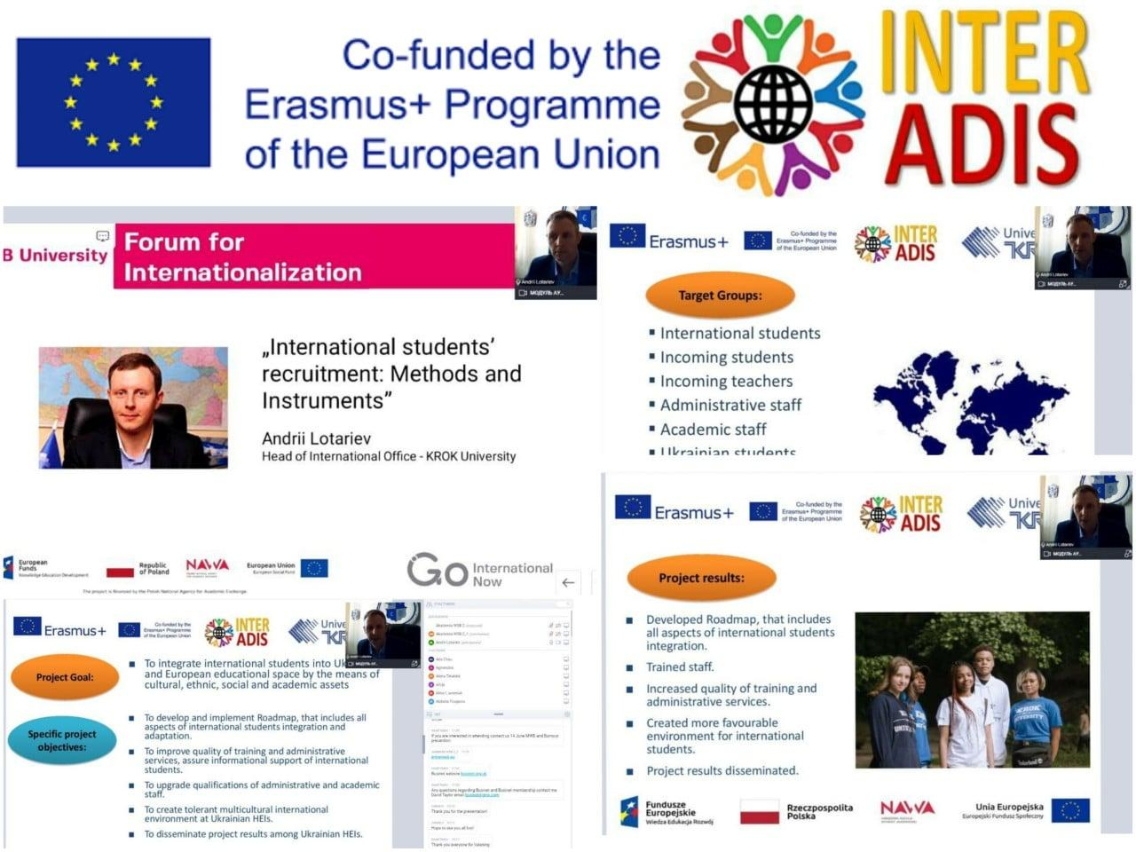
Presentation of INTERADIS at "4th Internationalization Forum"
25 May 2021 Andrii Lotariev, Head of International Office of KROK University presented Erasmus+ project INTERADIS "International Students Adaptation and Integration" to more than 150 Universities from the EU and beyond at "4th Internationalization Forum" organized online by WSB University / Akademia WSB Dąbrowa Górnicza, Poland 24th-27th May.
This year edition of the forum focused on increasing positive feedback of international students by touching aspects such as students tailored services, inclusive international mobility programs, building up of intercultural competences and students employability skills, integration of international students with local students and academic community etc.
InterUni Forum for Internationalization aims to broaden knowledge, exchange experiences in the field of: supporting foreign students and building intercultural competences; management of foreign student service activities; education in foreign languages; overcoming adaptation problems among foreign students; broadening integration and building attitudes of openness and tolerance in the context of universities and the local environment. The forum is attended by students and employees of universities, experts in the field, representatives of domestic and foreign partner universities. It creates a platform for dialogue between groups involved in the process of providing services and education to foreign students and the local community.

Slide 32
WP 7. Project Management
Grant Agreement
Partnership Agreement
Meetings of PSCMs
General concepts

Slide 33
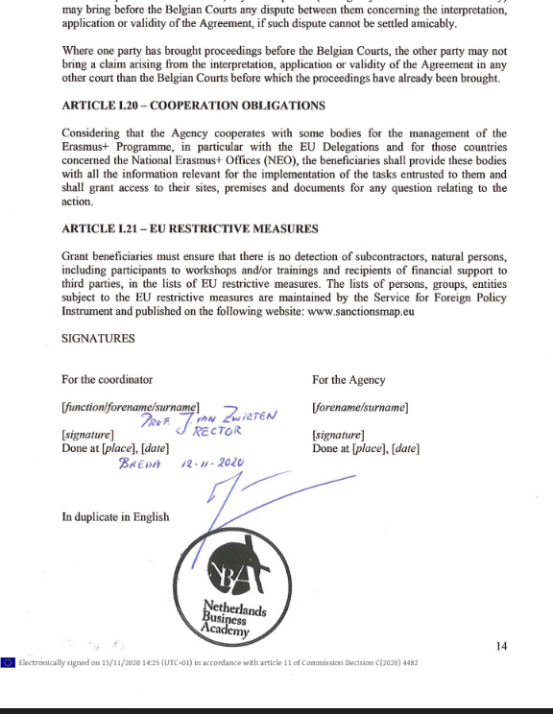
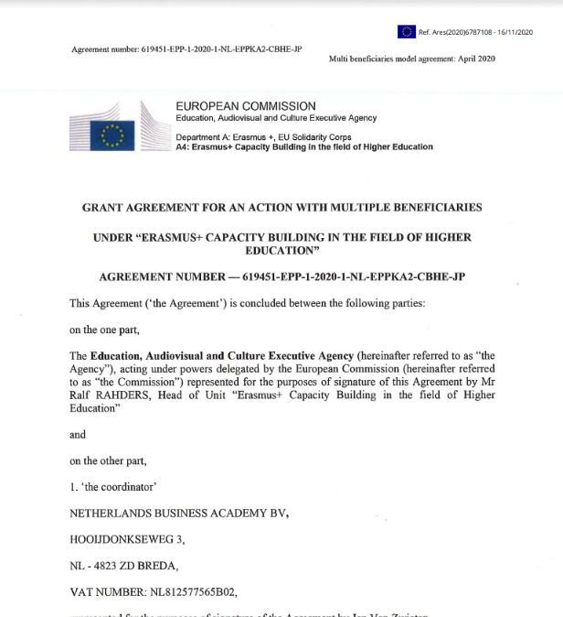
Grant Agreement
GA was signed

Slide 34
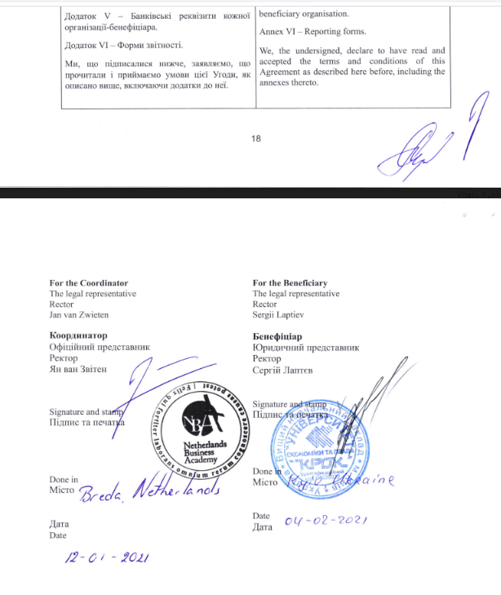
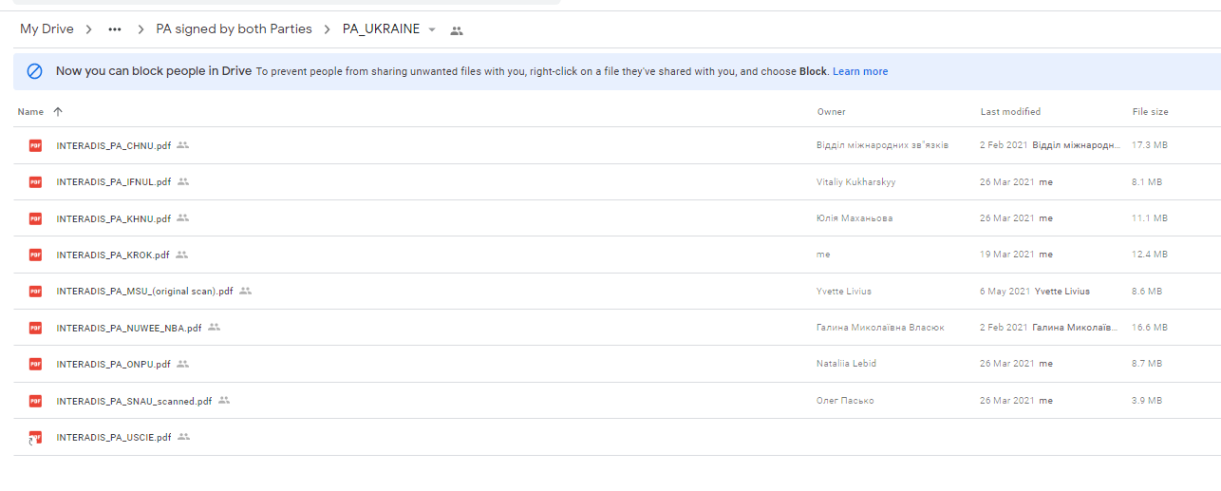
Parthership Agreements
Signed by Coordinator and Partners, scans were sent and accepted by EACEA in 6 months term, Coordinator has the originals.

Slide 35
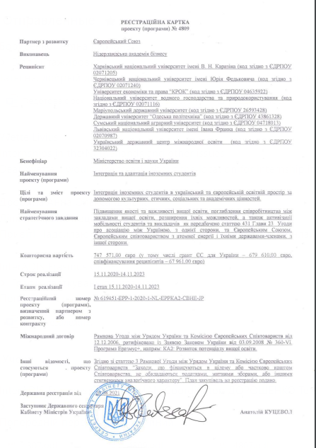
Project registration in Ukraine
The project is registered.
Procurement procedure has started.

Slide 36
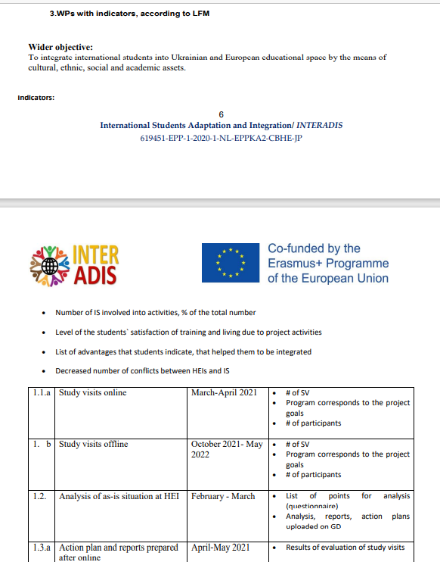
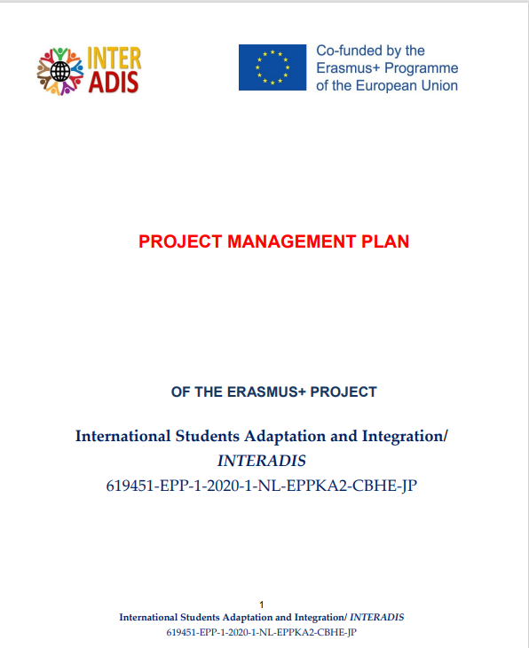
Project Management Plan
PMP developed, uploaded to Google drive

Slide 37
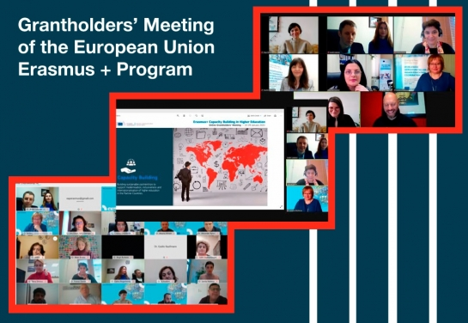
Participation at Grantholder`s Meeting
On January 25-29, 2021, series of presentations and workshops on the rules of implementation of CBHE projects, meetings of the project teams with Project Officers of the Education, Audiovisual and Culture EC Executive Agency (EACEA), with participation of representatives of the EU Directorate Generals, the EU Delegations in the partner countries, the Erasmus + National Offices and the National Erasmus + Agencies took place. Issues of the current state and future perspectives for capacity building in higher education, the role and responsibilities of higher education institutions, the implementation, monitoring and financial management of CBHE projects, as well as project management during the COVID-19 pandemic were discussed on the first day of the event.

Slide 38
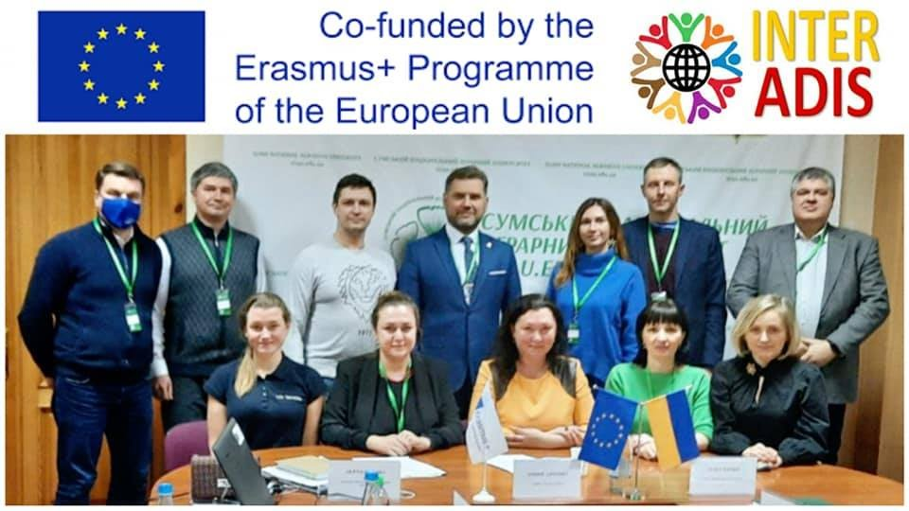
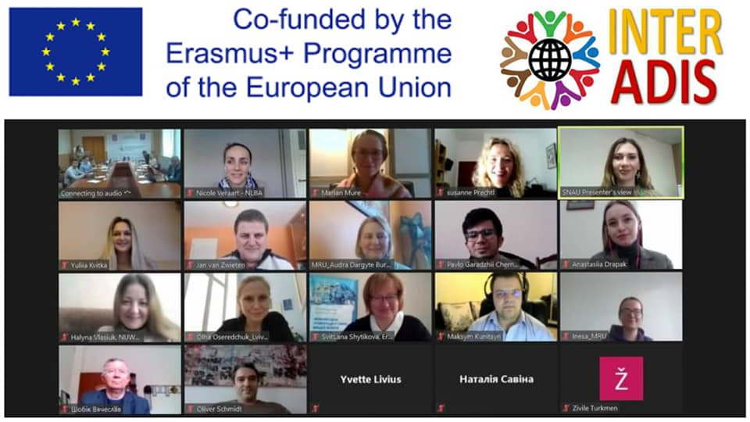
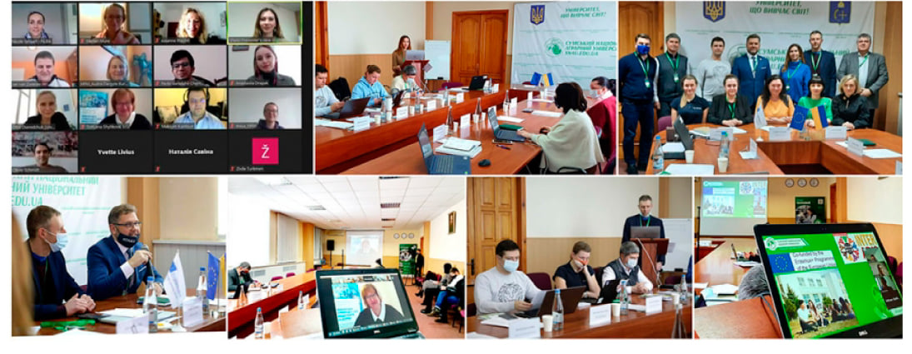
Kick-off meeting
11-12 February 2021 online and offline Kick-off meeting of Erasmus+ CBHE Project International Students Adaptation and Integration/ #INTERADIS (619451-EPP-1-2020-1-NL-EPPKA2-CBHE-JP) was organized at Sumy National Agrarian University, Ukraine.
Oleh Sharov, General Director of the Directorate of Higher and Adult Education of Ministry of Education and Science of Ukraine; Madalena Rodrigues Pereira, coordinator of National Agency Erasmus+ in the Netherlands; Svitlana Shytikova, director of National Erasmus+ Office in Ukraine welcomed the participants.
The EU partners presented their organizations focusing on expertise regarding different aspects of work with International students. Key project issues including project goal, specific project objectives, indicators of the progress, project timeline, workpackage activities were described in details.
On the second day management, financial and administrative issues: including roles and responsibilities of the Coordinator team and Partners, cooperation and communication, payment arrangements, reporting, documentation, quality management were discussed. Special attention was given to dissemination, sustainability and visibility rules, the to-do list for start of project promotion was announced. Svitlana Shytikova provided valuable comments and answered to the questions of partners during the whole meeting.

Slide 39
Protocol of the kick-off
Budget overview
Unit costs
Actual costs
Eligible, not eligible costs
Staff costs
Employment contracts
Supporting documents for staff costs
Joint Declaration
Timesheet
Travel Costs and Costs of Stay
Equipment
Subcontracting
Supporting documents
VAT
Exchange rate
Roles Coordinator – Partners
Project Steering Committee
Workpackage owner
Contact Person
Cooperation and Communication
Staff Categories
Visibility Rules
Penalties
Tasks for the nearest future

Slide 40
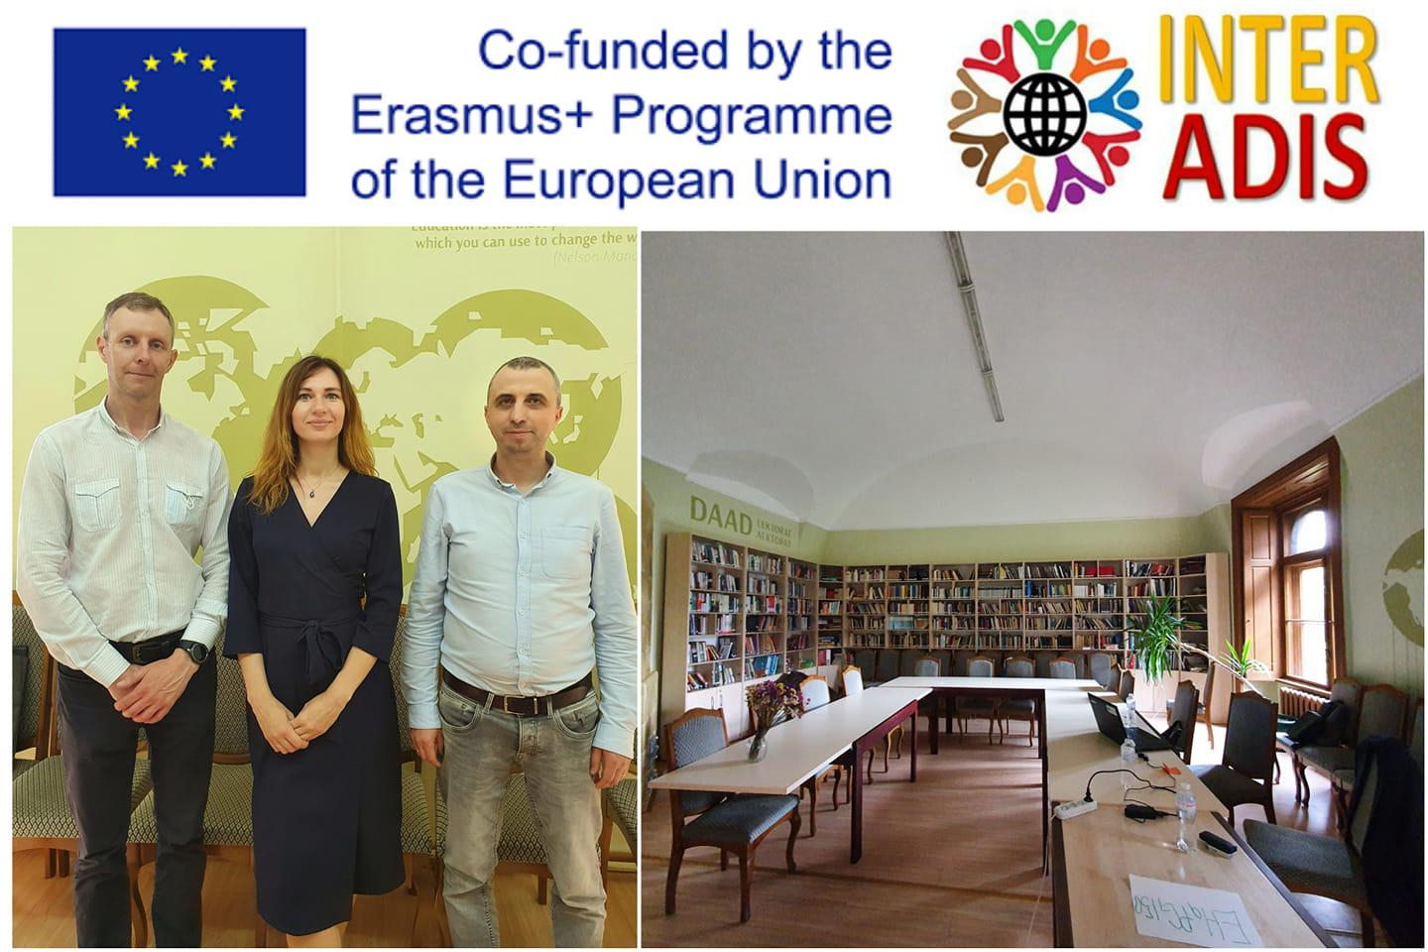
Bilateral Meeting between INTERADIS partners
On 18 June 2021 team of KROK University visited Yuriy Fedkovych Chernivtsi National University in the frameworks of the Erasmus+Project MEDIATS Mediation: Training and Society Transformaiton. Andriі Lotariev, Head of International Office, and Halyna Bohachenko, Projects and Programs Manager of Internaitonal Office of KROK discussed with Sergiy Lukanyuk, Head of International Office of CHNU the crucial aspects of implementation of INTERADIS project. Sergiy presented the room for co-working zone for International students and shared the plans for further steps in its preparation

Slide 41

Bilateral Meeting between INTERADIS partners
1 July 2021 Andrii Lotariev, Head of International Office of KROK University, and Galina Bogachenko, Projects and Programs Manager of KROK IO visited Ivan Franko National University of Lviv. Vitaliy Kukharsky, Vice-Rector for Research and Education and Informatization of IFNUL and Olha Oseredchuk, Head of Marketing and Development Center organized warm visit for the KROK team, presented IFNUL, very beautiful and one of the oldest Universities of Ukraine and Eastern Europe.
The project teams had a fruitful meeting discussing tasks, activities, perspectives of INTERADIS project, sharing experience in development and implementation of Erasmus+ projects and planning further initiatives.

Slide 42

Bilateral Meeting between INTERADIS partners
Informal meeting of #INTERADIS partners in Odessa, 16 September 2021

Slide 43
Project Implementation in general
Консорціум дотримується термінів Робочого плану /деталізованого графіку робіт за проектом відповідно до розподілу відповідальностей за Робочими пакетами. Партнерство дотримується розподілу відповідальностей за Робочими пакетами. Є невеликі затримки у реалізації робочих візитів через пандемію коронавірусу та затримка деяких активностей у зв`язку з набуттям європейського досвіду.
The consortium adheres to the terms of the Work Plan / detailed work schedule for the project in accordance with the division of responsibilities for the Work Packages. The partnership adheres to the division of responsibilities under the Work Packages. There are slight delays in working visits due to the coronavirus pandemic.
Проект дотримується вимог донора щодо візуалізації проекту. Є стратегія та заплановані заходи щодо візуалізації проекту.
Лого програми Еразмус+ та проекту розміщено на вебсайтах університетів. користувачі вебсайту інформуються про хід реалізації та досягнуті результати проекту.
Створено вебсайт проекту. KROK відповідальний за його адміністрування. Оновлюється новинами проєкту, результатами. Сайт доступний англіййською мовою. Орієнтований зміст сайту на поширення інформації щодо досягнутих результатів проектом. Вебсайт проекту буде підтриммуватись після завершення проекту.
The project complies with the donor's requirements for project visualization. There is a strategy and planned measures to visualize the project.The logo of the Erasmus + program and the project is posted on university websites. website users are informed about the implementation and achieved results of the project.Project website created. KROK is responsible for its administration. Updated with project news, results. The site is available in English. The content of the site is focused on the dissemination of information on the results achieved by the project. The project website will be maintained after the project is completed.
Університети отримали 50% коштів, без коштів на обладнання, яке буде оплачено напряму.
The universities received 50% of the budget excluding costs for equipment, that will be paid directly to the company supplier.

Slide 44

Thank you for your attention!

